Slide 1

Chapter 1: Setting the field
(c) Antonella Zucchella, Birgit Hagen and Manuel G. Serapio, 2023

Slide 2
Chapter 1 – Setting the field
International entrepreneurship: what, who, why
Theory perspectives
The environment of international entrepreneurship: across countries and cultures
IE and comparative entrepreneurship
Case studies: BTS and K Pop

Slide 3
International Entrepreneurship: what, who, why
What
“… the discovery, enactment, evaluation and exploitation of opportunities – across national borders – to create future goods and services.” (McDougall and Oviatt, 2005)
Who
Entrepreneurs, top management team: key decision makers
Their organisations (international entre-preneurial organisations, of different types)
Why
A more interconnected world and an increasing international orientation in people and organisations
The distance paradox: threats and oppor-tunities from distance in a (more or less) global world

Slide 4
International Entrepreneurship – fast forward from the 1980s onwards
  International New Venture (INV): “start-ups that, from their inception, engage in international business, thus viewing their operating domain as international from the initial stages of the firm’s operation” (McDougall, 1989: 390)
  “... a business organization that, from inception, seeks to derive significant competitive advantage from the use of resources and/or the sale of outputs in multiple countries” (Oviatt and McDougall, 1994:49)
  Born Global Firm (BGF): “Being born global means that exporting was the primary goal of the firm even upon its inception. These firms have been able to attain as much as 76 % of their sales from exports after only two years of operation” (Rennie, 1993:45)
  “business organizations that, from or near their founding, seek superior international business performance from the application of knowledge-based resources to the sale of outputs in multiple countries” (Knight & Cavusgil, 2004: 124).

Slide 5

International Entrepreneurship – WHAT?
IE: “The discovery, enactment, evaluation and exploitation of opportunities – across national borders – to create future goods and services” (Oviatt & McDougall, 2005:540)
Formation and exploitation of opportunities
Creation of future goods and services
International, cross-border perspective

Slide 6
International Entrepreneurship – WHO?
In reading the book, have you found personal stories of international entrepreneurs?
What do they have in common?
Why and how did they start their international new venture?

Slide 7
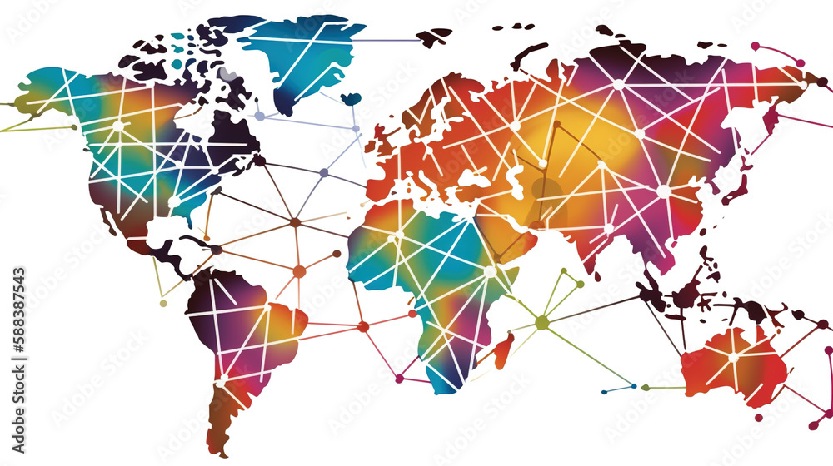
International Entrepreneurship – WHY?
An internationally dynamic and interconnected world
“Dramatic globalization drivers such as lower cost and faster communication technologies, lowering of trade and investment barriers, industry deregulations, and advances in chepater and more efficient means of transportation” (McDougall-Covin, Jones & Serapio, 2014:2)
A new generation of entrepreneurs with international experience and a global mindset

Slide 8
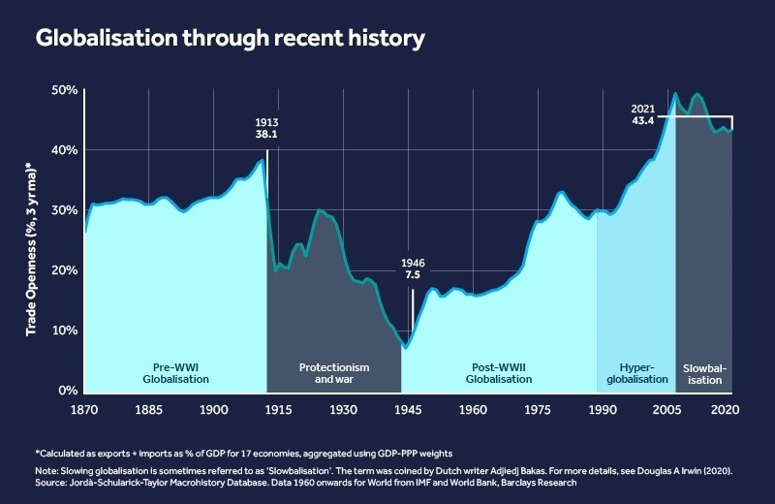
What about the recent evolution? (a)
Is globalisation still a driving force?
Read the article by World economic Forum 2023 available at https://www.weforum.org/agenda/2023/01/deglobalisation-what-you-need-to-know-wef23/
What consequences for international entrepreneurship?
Source: World Economic Forum, January 2023
Available at https://www.weforum.org/agenda/2023/01/deglobalisation-what-you-need-to-know-wef23/

Slide 9

What about the recent evolution? (b)
International entrepreneurship and the grand challenges: the sustainability turn
What does sustainability mean? Which are its core dimensions?
How do the Sustainable Development Goals (SDGs) affect international entrepreneurship (opportunities and challenges)?
Source, United Nations. For more info https://sdgs.un.org/goals

Slide 10

What about the recent evolution? (c)
We often come across the term «digital transformation». What does it mean?
Which technologies are included in this term?
How do they affect the internationalization of the firm and the rise of international new ventures?
Source: free image from https://www.freepik.com/free-photo/

Slide 11

What characterizes international entrepreneurial organizations in this context?
Source: free image from https://www.freepik.com/free-photo/

Slide 12
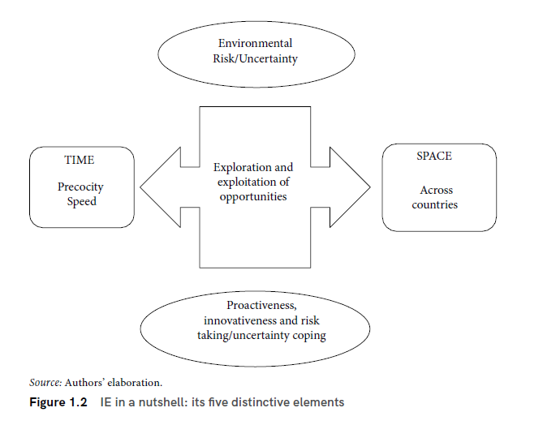
IE in a nutshell

Slide 13
The triple O in entrepreneurship
Orientation
to international markets of entrepreneurs and their organisations (proactiveness, risk taking, innovativeness)
Opportunities
exploration and exploitation, arising from from foreign contexts and relationships
Organisation
International entrepreneurial organisation, orchestration of resources and capabilities to explore and exploit international opportunities, at the start and during the life of the venture

Slide 14
Theory perspectives

Slide 15
IE and its parent disciplines
International entrepreneurship
International business
Management and configuration of international activities
Internationalization process
Entrepreneurship
The entrepreneurs and their organizations pursuing opportunities beyond resources controlled
Strategic Management
The use of resources and capabilities to achieve competitive advantage
Source: Authors’ elaboration, Figure 1.4.

Slide 16
IE and its research dimensions
2
Key constructs (Distance and opportunity)
3
Levels of analysis (individual, organization, network)
1
Phenomenon
(international growth)
Source, Author’s eleboration, figure 1.5

Slide 17
Comparing the international growth to other perspectives
The Uppsala model
The network approach

Slide 18

“Like rings in the water” – The Uppsala process model (Johanson & Vahlne, 1977)
Market operations
Key elements of the Uppsala 1977 model:
Psychic distance
Experiential knowledge
Establishment chain
Own foreign production
Own sales subsidiary
Direct export
Indirect export
Market development
Existing
National
Adapted
Regional
New
Global
Product offering

Slide 19
Networks approach
How does a network-based view affect the Uppsala model (1977)?
Consider how the Authors have proposed an update of their 1977 model (Johansson and Vahlne, 2009)
Can you observe some convergence between International Entrepreneurship and the latest updates of the Uppsala model?

Slide 20
The environment of international entrepreneurship: across countries and cultures

Slide 21

The environment or the entrepreneur?
Three views of entrepreneurship
Deterministic view : entrepreneurs and entrepreneurial action are determined by the external environment, e.g. institutions and industry
Independent view : entrepreneurs, and their traits and capabilities, drive entrepreneurial action
Intermediate view: Entrepreneurial action is the result of an interaction of entrepreneurs with their ‘environment’

Slide 22
Key environmental drivers of IE
A new and constantly changing economic landscape
Technology, in particular ICT, developments
International education, work, travel and communication - A "new breed" of entrepreneurs
Convergence * of political-legal institutions
* of customer needs and wants
Industry-specific dynamics

Slide 23


Comparative entrepreneurship
Cross-national comparisons of
domestic entrepreneurship, e.g. differences in entrepreneurial activity rates such business formation, innovation, internationalization
and entrepreneurial internationalization, e.g. determinants of entrepreneurial international activities at the micro-level

Slide 24
The role and the nature of ‘context’
Economic, political-legal, socio-cultural conditions define the ‘rules of the game’ (e.g. North, 1990)
The context impacts on
  the ‘supply’ of potential entrepreneurs, their characteristics, traits, and values
  and the market space that entrepreneurs find for their activity
A ‘strong and supportive institutional framework’ (laws, norms, standards)
  reduces uncertainty
  creates trust
  is positively related to entrepreneurial activity
  and economic performance

Slide 25
Context – Institutional framework
DEGREE OF FORMALITY
EXAMPLES
SUPPORTIVE PILLARS
Formal Institutions
Laws
Regulatory
(coercive)
legal
Regulations
Rules
Informal institutions
Norms
Normative
culture
Values
Cognitive
Ethics
  Formal and informal institutions govern individual and firm behavior
  Institutions signal conduct as acceptable or not (which constrains the range of acceptable actions)

Slide 26
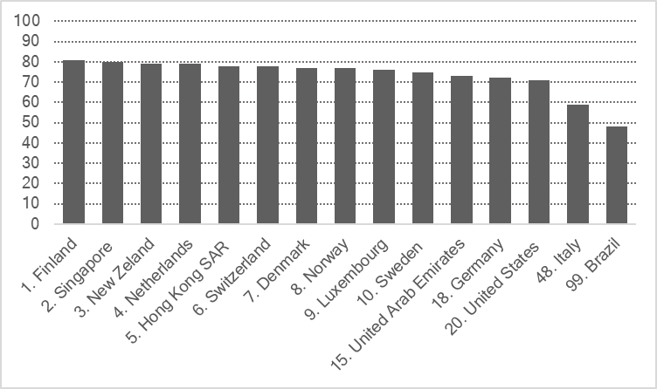
The economic and the regulatory environment (formal institutions) – institutional quality
1st pillar – Institutions of the World Economic Forum
Rank 1-7 (best); includes public institutions such as property rights, IPP; ethics and corruption; undue influence;
public sector performance (e.g. burden of government regulation; efficiency of legal framework in settling disputes),
security (e.g. business cost of terrorism, organized crime); and private institutions (corporate ethics, accountability)

Slide 27
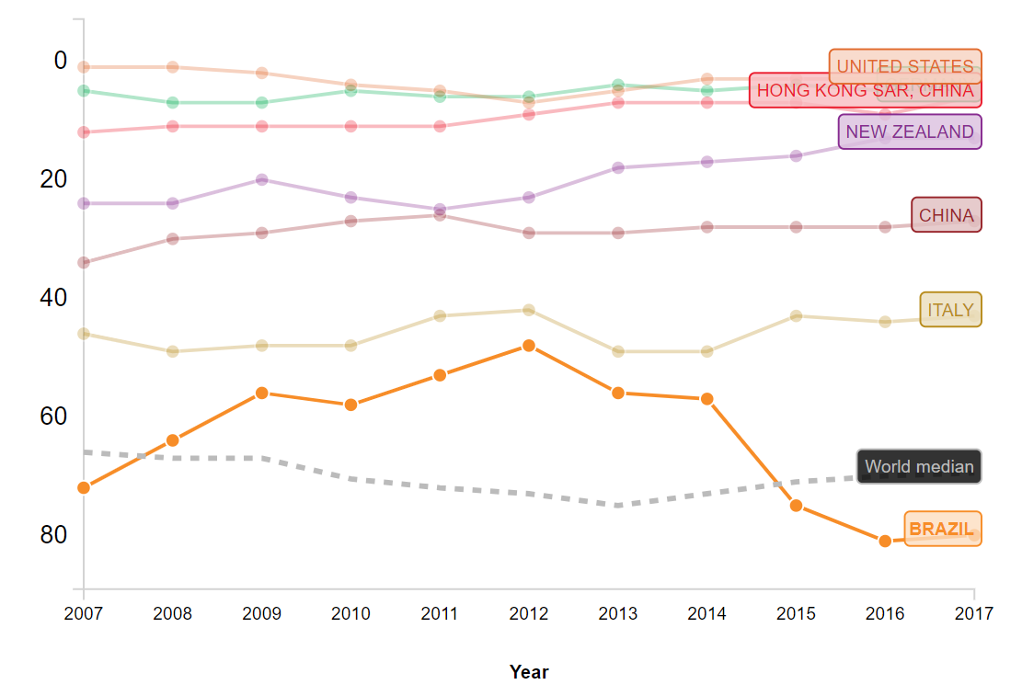
The Global Competitiveness Index – World Bank
The Global Competitiveness Index – data platform https://tcdata360.worldbank.org/indicators/gci?country=BRA&indicator=632&countries=USA,ITA,DEU,CHN,HKG,NZL&viz=line_chart&years=2007,2017#related-link
Related indicators:
Soundness of banks
Ease of access to loans
Venture capital availability
Financing through local equity market
Country capacity to retain talent
Domestic market size
Control of corruption
Degree of customer orientation etc

Slide 28
Ease of doing business
Trading across borders
Doing
business
Starting a business
Registering
property
Getting credit
Paying taxes
Enforcing contracts
Resolving insolvency
Note: Ranks from 1 to 190; a high ease of doing business ranking mean that the regulatory environment is more conducive to the starting and operation of a focal firm.

Slide 29
The cultural environment (informal institutions)
Norms, values, ethics form attitude and intention toward entrepreneurial activity
In Europe, a serious social stigma is attached to bankruptcy. In the US, bankruptcy laws allow entrepreneurs who fail to start again quickly and failure is considered part of the learning process. In Europe, those who go bankrupt tend to be considered “losers”.
European Commission, 1998

Slide 30

The Small Business Act for Europe
Recognizing the importance of overcoming the stigma of business failure, the EU has introduced its “second chance policy” in 2007 and devoted the second of its 10 principles to this in the Small Business Act for Europe”.
https://ec.europa.eu/growth/smes/business-friendly-environment/small-business-act_en

Slide 31

Success & Failure - attitude
Fear of failure rate
(GEM 2021)
US 42
Italy 45
Switzerland 30
India 54
‘Good decisions come from experience and experience comes from bad decisions’. Anonymous

Slide 32
Fear of failure rates & much more
The Global Entrepreneurship monitor
https://www.gemconsortium.org/data

Slide 33
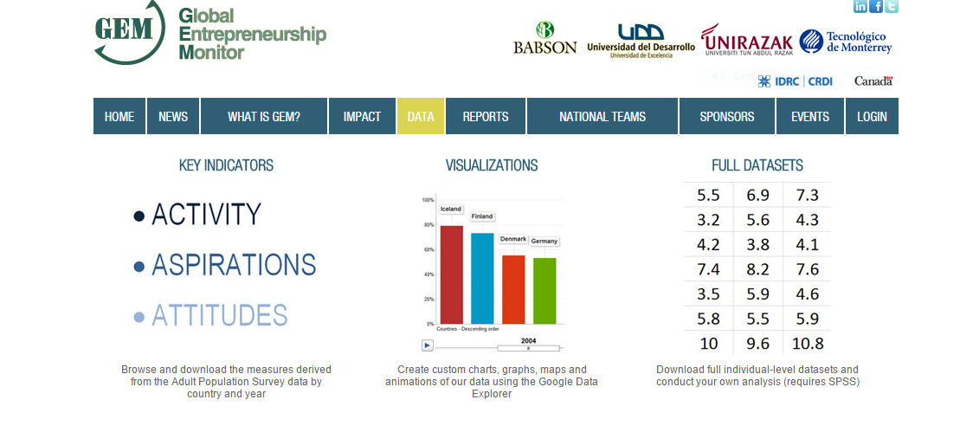
Global Entrepreneurship Monitor
23 years of data
>100 countries
>250.000 interviews…..

Slide 34
Global Entrepreneurship Monitor
Activities, eg TEA Total early stage Entrepreneurial Activity; nascent entrepreneurship rate, type of activity
Aspirations, eg growth expectation, new product early-stage entrepreneurial activity, international orientation
Attitudes, eg entrepreneurial intentions, career choice, fear of failure

Slide 35
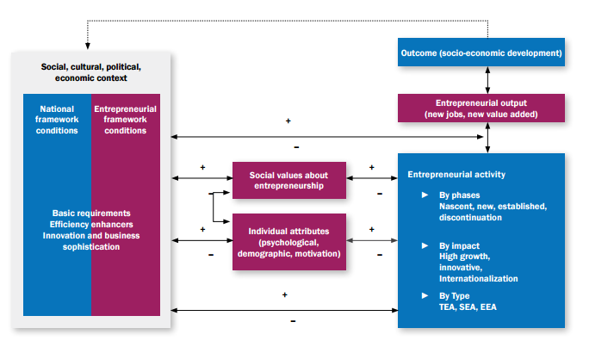
The GEM framework
Outcome (socio-economic development)
Socio-cultural, political,
economic context
Entrepreneurial output (new jobs, new value added)
Entrepreneurial activity
Adpated from GEM Global Report 2017

Slide 36
An example of GEM-data
Total Early-Stage Entrepreneurial Activity (TEA)
Potential entrepreneurs: interest and skills
Entrepreneur in an established company (more than 3.5 years old)
Nascent Entrepreneur: engaged in starting a company
Entrepreneur in a young company (until 3.5 years old)
Conception
Birth of the Firm
Survival

Slide 37
An illustration of GEM data
Country | Entrepr. Inten-tions | Total early stage entrepr. Activity | Perceived oppor-tunities | Perceived capabili-ties | Inno-vation | Motiv-ational index¹ | Fear of failure
Brazil | 28 | 18 | 31 | 54 | 3,7 | 1,3 | 33
Germany | 6 | 5 | 42 | 38 | 30,5 | 3,1 | 45
China UAE | 15 38 | 10 11 | 35 67 | 24 53 | 33 28,2 | 0,9 2,5 | 42 24
Italy | 9 | 4 | 35 | 30 | 24,2 | 2,7 | 52
United States | 12 | 16 | 70 | 56 | 33,9 | 6,9 | 35
Percentages of 18-64 population who agree with the statement; indicate to have the required skills to start a business;
who intend to start a business within 3 years; who are nascent entrepreneur or manager of a new business.
1) % improvement driven – opportunity-motivated divided by % necessity-motivated

Slide 38
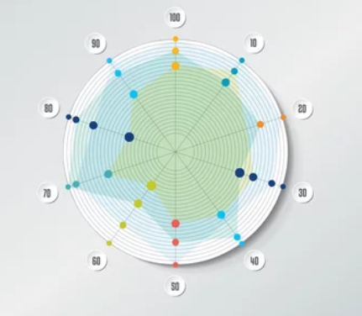
Compare country profiles: The European Commission Small Business Act factsheets
https://single-market-economy.ec.europa.eu/smes/sme-strategy/sme-performance-review_en#paragraph_885

Slide 39

Comparative entrepreneurship: entrepreneurial internationalization across countries
Limited insights, despite large cross-national variations
Evidence that
countries with strong economic, regulatory and normative institutions strengthen new venture competitive advantage – foster internationalization
small markets, non-attractive markets push new ventures abroad

Slide 40
Chapter 2: International entrepreneurial organizations: characteristics and typologies
(c) Antonella Zucchella, Birgit Hagen and Manuel G. Serapio, 2023

Slide 41
International entrepreneurial organizations: characteristics and typologies
The characteristics of international entrepreneurial organizations (IEO): what do they have in common?
Typologies of IE beyond international new ventures and born global firms
International sustainable entrepreneurship: environmental and circular entrepreneurship
International sustainable entrepreneurship: international social entrepreneurship
Case study: Touch-a-Life Foundation

Slide 42
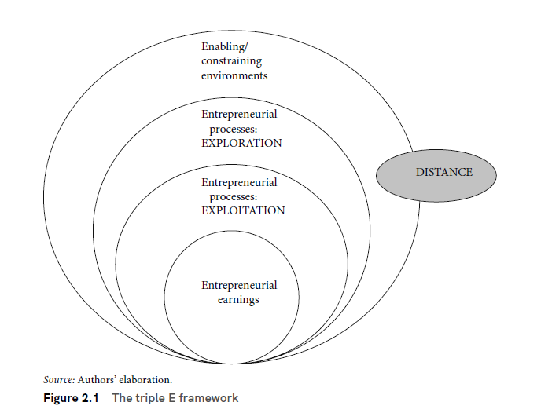
Common characteristics of IEOs

Slide 43
Different types of IEOs: international new ventures and born global firms
  International New Venture (INV): “start-ups that, from their inception, engage in international business, thus viewing their operating domain as international from the initial stages of the firm’s operation” (McDougall, 1989: 390)
  “... a business organization that, from inception, seeks to derive significant competitive advantage from the use of resources and/or the sale of outputs in multiple countries” (Oviatt and McDougall, 1994:49)
  Born Global Firm (BGF): “Being born global means that exporting was the primary goal of the firm even upon its inception. These firms have been able to attain as much as 76 % of their sales from exports after only two years of operation” (Rennie, 1993:45)
  “business organizations that, from or near their founding, seek superior international business performance from the application of knowledge-based resources to the sale of outputs in multiple countries” (Knight & Cavusgil, 2004: 124).

Slide 44
Different types of IEOs: From early internationalizeres to Born Global firms
Time and space in BGs | Regional scope | Global scope
Early | Early Internationaliser | Early global
Fast | Fast internationaliser | Fast global (born-again global)
Early and fast | Born international | Born global
Late and slow | Traditional,gradual internationalisers

Slide 45

The many emerging facets of international entrepreneurship
Migrant entrepreneurship
Environmental, green and circular entrepreneurship
Social entrepreneurship
What else?
Free image from: https://www.freepik.com/free-vector/diaspora-abstract-concept-vector-illustration-jewish-diaspora-forced-movement-star-david-living-outside-ethnic-religious-group-jewish-communities-foreigners-group-abstract-metaphor_12468694.htm#query=migrant%20immigrant%20business&position=14&from_view=search&track=ais">Image by vectorjuice</a> on Freepik

Slide 46
Sustainable entrepreneurship
Sustainable entrepreneurship encompasses the diverse sustainability issues, from the environmental to the social ones.
Environmental or “green” entrepreneurship addresses specifically the environmental grand challenges
A specific domain in environmental entrepreneurship is represented by circular entrepreneurship, as defined by Zucchella & Urban (2019), based on the circular economy principles and adopting circular business models aimed at closing, narrowing or slowing the resources loops. These business models correspond to recycling materials, reusing, refurbishing products and repairing products, reducing the use of materials and energy.
The internationalization of sustainable entrepreneurship: which challenges and opportunities?

Slide 47

Different firm context: international social entrepreneurship
Social value creation, instead of creating personal or stakeholder wealth, is the primary driver for the entrepreneurial activity.
Social entrepreneurship shows
how to mobilize resources in adverse environments or situations of institutional voids
the cooperative stance and mechanisms to circumvent or change environmental barriers
the importance of cultural understanding and how understanding of different, multiple contexts give rise to the identification of international opportunities.

Slide 48
International social entrepreneurship
From Schumpeter’s (1934) social value allocation to social value creation
Two central and common elements in various definitions of SE:
1) the entrepreneurial dimension
2) the social dimension
The formation and exploitation of an opportunity with “mission-related impact” with the social mission at the centre of the venture – hybrid/blended posture

Slide 49
International social entrepreneurship
Intersection between IE and Social Entrepreneurship: many social issues are international
Committed, empathic entrepreneurs see opportunity where ‘the market’ fails or that others do not see worth addressing
International Social Entrepreneurship emphasizes
Importance of networks and mission-aligned and locally embedded partners
Understanding of context (international, local, social)
Design of an effective business model built around the social mission
Bottom-up approach to exploit collective intelligence
Legitimacy as a key factor

