Slide 1
Chapter 5: International Entrepreneurial Entry – Implementation Processes
(c) Antonella Zucchella, Birgit Hagen and Manuel G. Serapio, 2023

Slide 2
Chapter 5: International entrepreneurial entry - implementation processes
“How to play?” A word on business models and the lean start-up framework
Selecting markets, customers, and partners
Market entry
Entrepreneurial marketing as a key driver of entrepreneurial internationalization
From childhood to maturity – managing long-term growth
Case study: ofo: the rise and fall of a global unicorn company

Slide 3
Design and implementation decisions – interdependent and simultaneous
How can I attract, reach, and keep them better than competition?
Where are they?
Who are my customers?
The international dimension e.g.
Value proposition must be attractive to customers in many markets
Marketing programmes must be replicable or easy adaptable abroad
Which segments/markets first?
Where should we locate the business and the various business functions?
Staffing and governance aspects extend from national to international markets

Slide 4
“How to play?” A word on business models
Business modeling approach:
is a “conceptual model”, a way to deal with simultaneous design and implementation decisions under conditions of resource scarcity and uncertainty;
conceptualizes the venture as an interdependent set of strategic choices regarding value propositions, choice of customer segments, partners, revenue models;
seeks complementary relationships through unique combinations;
develops activities around a logical framework;
ensures consistency between elements of strategy, architecture, economics, growth, and exit intentions;
makes the strategic choices explicit.
Notes:
Check pic

Slide 5
Strategic intent: be a low cost, high value provider of financial services; high levels of customer service.
Set of various realization options: branch banking, selling retail banking products through the ING insurance network; model without branches.
Set of various entry products: brokerage, managed funds, credit cards, consumer loans, saving account.
Which market to enter (for a test): Anglo Saxon countries (because of more established direct distribution) and smaller countries – Australia and Canada: closer to Europe and dominated by five major retail banks which offer consumers little variety or real choice.
Through successful testing clarification of the core business model elements: branchless banking, simplicity, low cost, value for money/fairness, local teams preferably without banking experience; “fleet of local companies (i.e. subsidiaries)” with high degrees of freedom.
Country selection: two key criteria – local telecommunication/Internet infrastructure needs to be sufficiently developed to support direct banking; country must have market minimum size of > €100 billion held in savings accounts to attain a cost-effective operational scale.
Adaptation to contextual differences in various countries: individual marketing and promotional campaigns differed significantly. E.g. positioned as “your other bank” in Australia, “new style of money management – fresh, modern, innovative…” in France; some adaptation of product range: balance account in France is higher because savings in France face strong competition with Livret A (a tax free, fee-free saving account) sponsored by the French government; different performance and customer service monitoring systems and levels because of local regulations of account openings: great differences in “time to open” accounts; call centres in Italy could not record calls due to labour legislation etc.
(Dunford, Palmer and Benveniste, 2010)
Notes:
Pumpkin – associated with safety – only in Italy;

Slide 6
Table 5.1: Main pillars and questions that underlie business model design and implementation
Pillar 1 offering (value proposition): how do we create value? | Pillar 2 customer segments & customer relationships: for whom do we create value? | Pillar 3 Key activities & Key resources?
collection of products and service | Customer archetypes/type of organizations | production/operating systems
product itself/ product bundled with other firm’s product and services | regional/national/international customers? | selling/marketing
Various elements, e.g. newness, performance, customization, convenience to understand the levers of customer wants | where is the customer in the value chain? | information management/mining/packaging
image of operational excellence/consistency/dependability/speed | One/ or multiple segments | technology/R&D/creative or innovative capability/intellectual
product or service innovation/quality/features/availability | How do we get/keep/grow customers | financial transactions/arbitrage
intimate customer relationship/experience | Which relationships do we have established? How costly are they? | supply chain management
low cost/efficiency |  | networking/resource leveraging
Pillar 4: Key partners | Pillar 5 Cost structure & revenue streams: How do we make money? What are our cost structures? | Pillar 6 (personal/investor factors): What are our time, scope, and size ambitions?
Who are our key partners? Who are our key suppliers? | pricing and revenue sources | subsistence model
Which key resources are we acquiring from our partners? | operating leverage: high/medium/low | income model
Which key activities do they perform? | volumes: high/medium/low | growth model
 | margins: high/medium/low | speculative model
 | Most important costs – most expensive key resources and key actitivities

Slide 7
“How to play?” A word on the lean start up framework
Lean start up framework:
Helps in the search for and experimentation with business models to find a viable route to international customers and markets;
various hypotheses are put in the business model in order to understand how the business creates value for the customer and the firm;
experimentation with different value creating combinations and early testing with customers and partners, lead to the formation of the business model or its quick adaptation and change;
“cheap failure”, due to quick iteration, demands little resources;
co-testing with customers brings successful, scalable products and solutions quickly to the market.
Notes:
Check pic

Slide 8
Selecting markets, customers, and partners
Find and form the most attractive product/service-market combinations
‘Market’: geography and/or customer
Selection decisions depend on
external conditions (e.g. regulatory environment, socio-cultural trends, economic, and competitive conditions) and
internal factors (e.g. resources) determining the strategy and the means with which the offering is brought to that market
Strongly interlinked with
Decisions on entry mode and entry timing
Decisions regarding the marketing program
Notes:
Check pic

Slide 9
Selecting markets, customers, and partners
Normative models of market selection (causal approach)
assessment of the overall attractiveness and risks of the market;
idea that market data and information is available and meaningful;
emphasis on the systematic and data-based evaluation of market/segment attractiveness where
the definition of foreign market pattern comes first, i.e. the firm identifies the most attractive markets and/or customer segments,
marketing decisions are taken subsequently, i.e. the choice of the strategy and tools to reach the objective.
Notes:
Check pic

Slide 10
Selecting markets, customers, and partners
Market selection in entrepreneurial internationalizers has been shown to include:
Deliberate-causal approaches, i.e. an assessment of market attractiveness (e.g. size, access to advanced and sophisticated customers; selection of lead markets, growth markets);
the imitation posture (follow industry/competiton)
a ‘test’-market approach
“Serendipity” when
following a client or domestic partner abroad
the choice and use of partners and networks (referrals) leads to entry into a particular market (effectual approach).

Slide 11
Selecting markets – international expansion patterns
Market selection in the Uppsala process model (Johanson and Vahlne, 1977)
stepwise, incremental, sequential expansion starting from the home market;
Psychic distance postulate: similar countries are targeted first and more difficult later;
Depth instead of breadth
‘Born Globals’ have shown
early, rapid expansion into a large number of foreign markets;
that psychic distance is of little concern; or an
initial selection of psychically proximate markets but
with expertise, networks and entrepreneurial skills they move very quickly to psychically distant markets with more opportunities;
change quickly to distant and more promising markets if the “close” markets do not stand up to expectations;
Breadth instead of depth
Notes:
Check pics

Slide 12
Selecting the customer segment first
Getting the ‘right’ customer segments
Niche strategy
Reference customers
‘Bottom up’ analysis: from customers to markets
Notes:
Choose pic

Slide 13
Selecting markets, customers, and partners
Firm-, managment-, product-service related elements influence …
Rationale | Systematic - proactive | Non – systematic- opportunistic – reactive
Decision- making | Causal-deliberate | Effectual | Imitative
Strategies | Top down – contractible, restrictive | Bottom-up - expansive
 | “Outside-in” | “Inside-out”
 | Breadth | Depth
 | Offensive | Defensive
 | Long-term | Short-term
Information search | Extensive | Limited
Type of information | Secondary | Primary (experiential or from others)

Slide 14
Firm-specific factors |  | Firm external – host country factors
Product-service related | Innovative product with global appeal Technology advantage/ quality advantage Narrow product offering | Industry | High tech industries/knowledge intensive e.g. have shorter life cycles/windows of opportunity than more traditional industry; first mover advantages
 |  | Host country | Country – market attractiveness; marketing infra-structure; competition; country risk; Entry barriers – tariff-non tariff; geographic distance; psychic distance
Firm related – age and size | Resource constraints Specialization; flexibility; no path dependencies; quickly learning
Management related | Experience and knowledge of founders – impacts inter-national orientation and provides network contacts Strong customer orientation Risk taking – risk averse Psychic distance
Strategy-related | Offensive – defensive; long-term – short term

Slide 15
Market entry: Entrepreneurial perspective
Emerging entry modes
Theory of International New Ventures
International expansion does not follow a staged process
Domestic maturation is not a necessary condition
Not necessary to expand to proximate markets
Market entry factors: Speed (primary, e.g. born global companies), risk, and reward
Digital globalization has opened new options to reach international customers (cross-border transactions)
Cross-border bandwidth has grown 45 times larger since 2005
Digital platforms bring down cost of international transactions
Small business are becoming “micro-multinationals”
New use of platforms: to learn, find work, showcase talent, and build personal networks
Notes:
Check pics

Slide 16
Market entry: Entrepreneurial perspective
Entry modes and international entrepreneurship
Franchising
International licensing
Internationalization (brand and distribution format) without huge investments (money and human resources)
Large firms, smaller and younger ventures explore opportunities (e.g. McDonald’s)
‘Frantrepreneur’: Franchisee as a case of international entrepreneurship
Relies on partnerships and contractual arrangements
Internationalizes quickly an innovation, brand, process
Foreign market entry without using vast resources
Notes:
Check pics

Slide 17
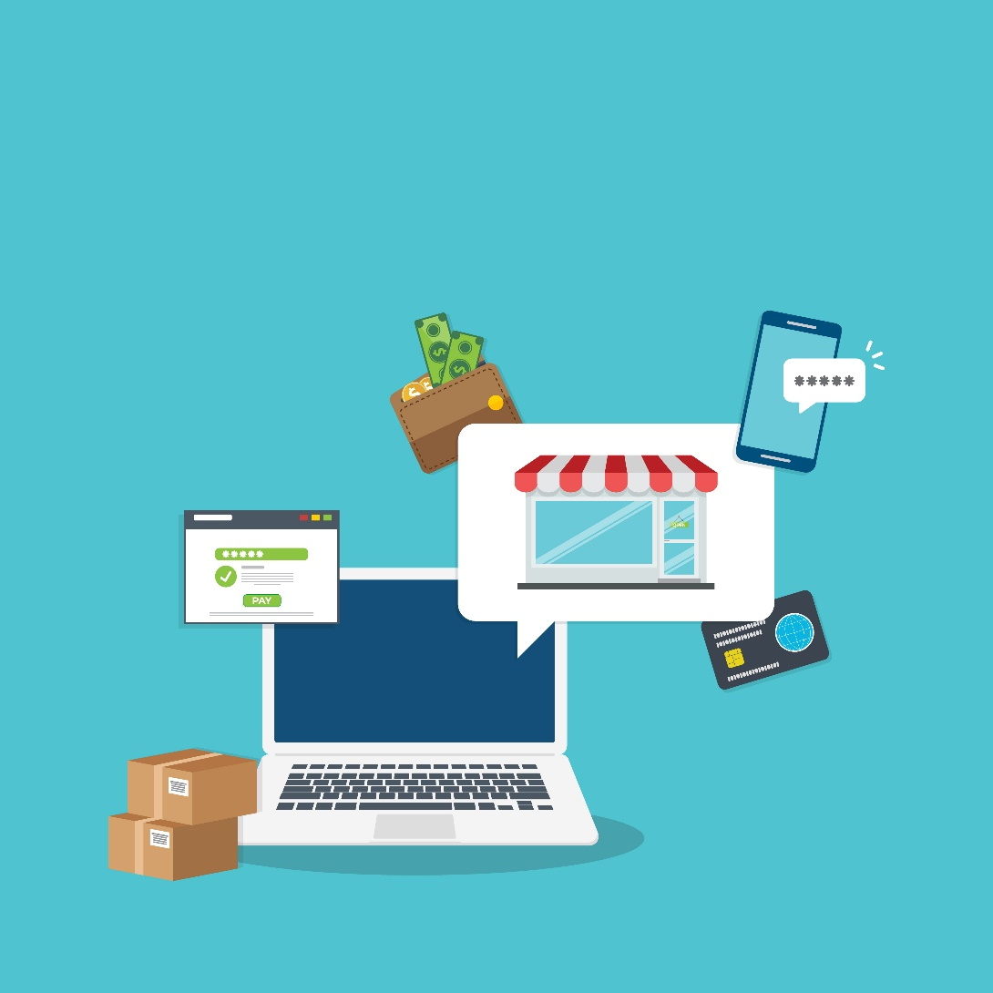
Market entry: Entrepreneurial perspective
Entry modes and international entrepreneurship
Cross-border retails sales (i.e. B2C) reached $793.7 billion in 2021, projected to reach $3 trillion by 2028
New dimensions: Global E-commerce
Cross-border sales that leverage the Internet or digital media
Enables new business models that lead to early and rapid internationalization (Born Global companies)
Spaces: B2B, B2C, and C2C in both goods and services
Route considerations: Choice of delivery and communication channels
Facets: Mobile commerce, e-payments, electronic data interchange, online transaction processing, and others
Online marketplaces: To reach customers in foreign countries. E.g. Lazada.com, specializes in Southeast Asian markets
Notes:
Check pics, numbers amended

Slide 18
The marketing challenge in entrepreneurial internationalizers
Develop an internationally viable value proposition and strategy
Identify and reach customers globally
Build and manage a global brand and market presence
Notes:
Check pic

Slide 19
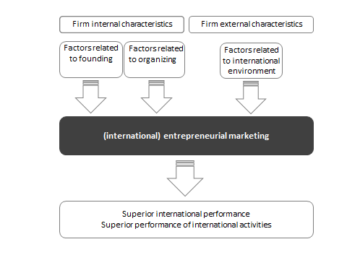
Marketing under ‘special conditions’

Slide 20
Entrepreneurial marketing
Doing marketing “differently”, “creatively”, “innovatively”….?
For small firms…? For new firms…? Only for firms with little resources? For all firms?
Conceptualized as
marketing activities in small and new (resource-constrained) firms
marketing in turbulent environments
non-traditional and/or digital marketing
a stage in the evolution of the firms’ marketing activities
a combination of entrepreneurial- and market-oriented posture
Notes:
Check pic

Slide 21
Entrepreneurial marketing built in key business processes – WHAT?
Exploit synergies! Leverage (scarce) resources!
Four business processes central for the creation of both customer and overall firm value (Srivastava et al., 1999)
Marketing is the glue across the firm –
it plays a key role in all firm processes
1) innovation management or business development;
2) value chain management;
3) (customer )relationship management;
4) the information and search process
5) Extension and enrichment of resources

Slide 22
Entrepreneurial marketing built in key business processes – HOW?
Read and act on signals from (international) customers
Innovation and business development through experimentation (e.g. formulation of hypotheses; co-creation with customers)
Relationship management with various partners and potential customers
Coordination and harmonization of multiple functions and partners across the value chain
Mobilization, leverage and extension of resources through creative management of resources
Notes:
Check pics

Slide 23
From Burbn to
Kevin Systrom started to learn to code, Foursquare (location check in) becoming popular
Built his prototype in HTML5, and called it Burbn
Gave out the unbranded version to friends and family for feedback
Met investors and showed them Burbn
Quit his job to pursue making his own company
Managed to get $500,000 in funding
Started to collaborate with Mike Krieger, an engineer with industry experience, first hire becomes co-founder
Decided to focus on the photo niche
Created a new photo app from scratch, but scratched it
Went back and started to look at Burbn again
Turned Burbn into an iPhone app
“wanted to be really good at one thing” Felt that the app was too cluttered, so discarded everything except for the photo sharing features
Tested and retested with friends and family, who also help to fix bugs
Renamed it Instagram – instant and telegram
Launched, and within a few hours became the number one photo app on the iOS store.
10,000 users downloaded the app within a couple of hours, from all across the world. After the first week, 100,000 users had downloaded the app, and by December the Instagram community had grown to an astonishing million
Reading and acting on signals – information search
Innovation through experimentation

Slide 24
Mobilization, leverage and extension of resources – creative management of resources
Scarce resources:
“Doing more with less”
Leverage structural flexibility of the small and young firm
Creative capacity of resource extension
Entrepreneurial marketing:
Imaginative – high
impact forms of
marketing
Influences nature
and level of demand

Slide 25
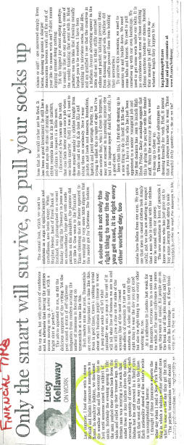
Extending and enriching scarce resources
Good story: “During a Japanese tea ceremony with clients I removed my shoes and, to my embarrassment, I realize my socks do not match. And even worse, one of my big toes is poking out”….
“Fate had picked me to remove the personal humiliation of inappropriate socks from the world”…the idea of the sock-scription
Subscription of black socks in different formulas coupled with an innovative business model
Notes:
pic which says business press

Slide 26
Information search based on customer contact
Uncertain environment
no predictability of demand
complex and varying signals
Where to find the «right» information”?
Customer-centric approach
Boundary spanning – core to marketing
Entrepreneurial marketing and customer contact:
Formulation of series of hypotheses
Helps to spot, evaluate and
assess opportunity better and quicker
Helps to respond quicker and better

Slide 27
Innovation and business development through experimentation
Rapid, frequent and inexpensive experimentation (Amit and Schoemaker, 1993)
Based on hypotheses regarding “new combinations” (Schumpeter, 1934)
Resource-conserving and a rapidly resource generating process
Entrepreneurial marketing:
Co-opts (international)
customers: co-creaters,
testers and multipliers of
new offerings
Anticipates the next
stages of (international)
growth for series of
experimentation
Is able to respond to
changes (that are not
envisaged)

Slide 28
In 2013, A.Ciliberti, a young Italian with a lot of entrepreneurial initiative and experience in fashion notices a lack of dedicated craft beer for the emerging street food gourmet scene.
He and some friends start visiting the shops they had identified: in around one month they try to better understand the emerging street food scene, the wants and ideas of their potential customers, and the value and potential of their idea of new and dedicated beers.
Feedback confirms the lack of adequate beers, especially in terms of quality, and it validates the value proposition – the dedicated high-level street beer.
The team also visits national/international food fairs to discuss the idea with the B2B segment. Many of the people consulted are so enthusiastic to provide contacts and ask for updates.
Andrea thus moves and starts of thinking of new and different types of beer recipes, supported by a quick market analysis regarding the most appreciated beer characteristics, taste, gradation, “recipes”, size and style of bottles and so on.
Together with an internationally experienced expert brewer who is passionate about the idea to develop street beer recipes, they finally develop three beers to be tested.
They also get endorsement and support from one of the most famous and important Italian brewers who decide to cooperate with experience, competence and reputation.
A small stock of around 100 bottles for each recipe is produced and tested, improved upon feedback and re-tested “on street” and “in shops” with old and new customers.
Two beer recipes fully met customer expectations after two rounds of testing and went into fully fledged production and online distribution.

Slide 29
Value chain management: coordination and harmonization of multi-stakeholder relations
Bonding – core to marketing
Networking: Leverage the assets, knowledge and competencies of external entities, e.g. customers, suppliers, distributors etc
Harmonize partner resources and capabilities with owned resources and do so with speed; effective strategies at network level
Entrepreneurial marketing:
Helps to find the “right”
partners
Cultivate customer
intensity & immunize;
CRM
Harness and harmonize
infrastructure and value
chain to produce value

Slide 30
Customer relationship management
Blacksocks with its funny and emotional approach excels in customer relationship management.
Outstanding CRM is proven by a retention rate of 80 % (reinforced by a winning subscription idea), and around 30 % of new customers brought in through existing clients.
Existing customers often are the first customers who adopt new products, increasing the overall value of their subscriptions and decreasing the overall cost of serving them.

Slide 31
The impact of entrepreneurial marketing
An example: Experimentation based on customer knowledge and hypotheses
reduces the firm’s overall uncertainty and risk by limiting it to and in a limited time,
resource and market space - may limit market-risk or failure
moves the products/services faster through the product adaptation process, helps to respond better
faster processes reduce not only the cost of adaptation but also the time for market acceptance
Entrepreneurial internationalization/superior international performance through
decreased time to market
early customer acceptance and accelerated market penetration
early economic return
positively altered risk profile

Slide 32
Managing long-term growth

Slide 33
From childhood to maturity
Initial stages of entrepreneurial internationalization well studied but little is known about longer-term development, survival and performance
What are the drivers of continued entrepreneurial internationalization?
How do growth patterns and internationalization paths of entrepreneurial internationalizers evolve on the longer run?

Slide 34
Kazanjian, 1988 | Gabrielsson et al, 2008
1st stage: conception and development | 1 stage: the introductory phase
Structure and formality are nonexistent; | Underdeveloped structure; limited resources
Creation of idea - Construction of protoype | Select channels/networks
Find financial backers | (Inter)national funding
Strategic positioning | Strategic positioning
 | Integrated operation -market strategy
 | Deliberate system for organizational learning
2nd stage: commercialization | 2nd stage: growth and resource accumulation
Org task system becomes a consideration; functions are created | Resource accumulation through organizational learning
Single owner, few people dominate | Self-finance though growth
Strategic positioning | Planning – strategy
3rd stage: growth | 3rd stage: break out and required strategies
To produce, sell and distribute product in volume and to avoid being shaken out of the market as ineffective or inefficient | Ties with global player/network
Pressure to attain profitability | Effective implementation of strategies
Balance profits against future growth | Global vision, commitment to rapid entry and market penetration
Growth of hierarchy; advent of functional specialization; move toward professionally trained, experienced people
Strategic positioning
4th stage: stability
Maintain growth momentum and market position
Second generation product;
Professional/experienced team support original owner

Slide 35
From childhood to maturity
Internal drivers | External drivers
Founder and team-related: international, industry entrepreneurial experience, management experience, commitment to growth, education; decision making logics; team openness and team composition (diversity, completeness) | Profile of target markets (e.g. institutional environment; growth potential, customer sophistication)
Entrepreneurial orientation at individual and firm level | Affiliation to industrial districts
Niche strategy; marketing differentiation; innovative-high quality products; different types and combinations of growth strategies | Networks
Various resources and capabilities: Finance, R&D, techno, marketing, networking; resource acquisition | Industry (dynamics)
 | Macro conditions (technology, ICT, globalization etc)

Slide 36
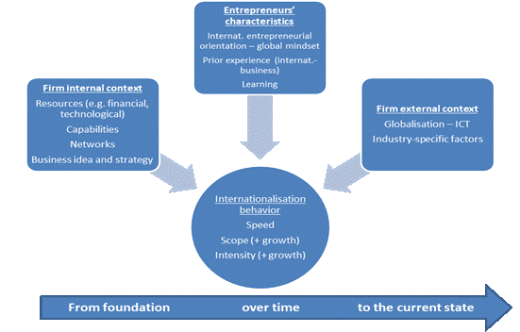
From childhood to maturity

Slide 37
Discussion questions
1. Do you see benefits of bringing the business model and lean start up methodology to entrepreneurial internationalizers? Discuss.
2. Please discuss ‘market’ selection decisions in the context of causation and effectuation logics. Give examples for each.
3. Please illustrate the impact of entrepreneurial marketing on international performance. Give examples.
4. What are the short- and the longer-term drivers of Born global internationalization trajectories?

