Slide 1
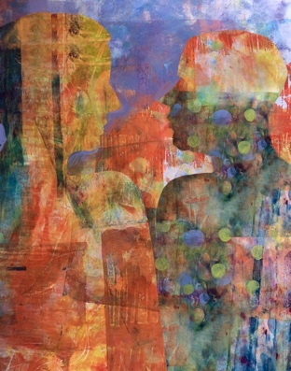
Ethical Leadership:
A Primer
Chapter 9
Divine Command Theory
James N. Thomas

Slide 2
Framing Question
‘What does the divine require from leadership?’

Slide 3
Timeline

Slide 4
History
Based in religion (chapter focuses on mono-theistic religions, specifically Christianity)
Early Christian thinkers
St. Augustin
St. Bernard of Clairvaux
St. Thomas Aquinas
St. Andrew of Neufchateau
Later Christian thinkers
John Duns Scotus
Søren Kierkegaard
Contemporary Christian thinkers
Philip Quinn, Divine Commands and Moral Requirements (1978)
Richard Mouw, The God Who Commands (1990)
Robert M. Adam, Finite and Infinite Goods (1999)

Slide 5
Major Concepts
Right and wrong are derived from God and emerge in two distinct ways:
(1) Natural Law, which argues that all humans are imbued with the values of life, procreation, knowledge, and sociability and God’s will is reflected in the moral reasoning and ethical behaviour that result; and
(2) Divine Command, which declares something morally good or ethically right based on whether or not it conforms to the will of God as revealed in divine commandments and holy texts

Slide 6
Critiques
The Euthyphro dilemma
Human free will

Slide 7
Key Quote
‘In light of the Five Components of Leadership Model, we might compare the largest circle of ‘cultural values and norms’ to the divine itself and the next larger circle of ‘context’ to the commands issued by the divine. These outer circles are accessible to both leaders and followers and become the ultimate criteria by which we judge the rightness of a goal.’

Slide 9
Case Study: A faith-based response to global injustice

Slide 11
Discussion Questions
What is your view of God and ethics? How can a theistic framework help or hinder a better understanding of ethics and leadership?
What are the benefits of a divine command theory of moral obligation as an ethical framework? What are its disadvantages? How might these disadvantages be overcome to sustain a viable ethical theory?
What role does human autonomy play in the development of divine command theory? How does reason factor into the connection between divine command theory and human independence?

Slide 12
Discussion Questions
What leadership benefits might be obtained from adherence to divine command theory? What leadership challenges might arise from such a theory?
How does the leader-follower dynamic in divine command theory speak to a sustainable, ethical framework for leadership? How do context and culture in divine command theory support the leader-follower dynamic in helping them reach their desired goals?

