Slide 1
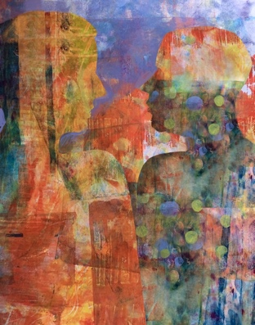
Ethical Leadership:
A Primer
Chapter 4
Virtue Ethics
Sabrina Little &
Molly Reed-Waters

Slide 2
Framing Question
‘What virtues should a leader possess to act ethically?’

Slide 3
Timeline

Slide 4
History
Plato and Aristotle (4th and 3rd Century BCE)
Mencius and Confucius (Circa 5th and 3rd Century BCE)
Stoics (Circa 5th – 3rd BCE)
Thomas Aquinas (1225–1274)
G.E.M Anscombe, P. Foot, A. MacIntyre, J. McDowell, and
J. Slote (20th Century)

Slide 5
Major Concepts
Function
Eudaimonia
Moral and intellectual virtues
Acquiring virtues

Slide 6
Major Concepts
Personality and character
Virtues and vices

Slide 7
Critiques
Action-guidingness
Egoism
Situationism
Moral luck

Slide 8
Key Quote
‘Virtue ethics focuses on the leader’s character and how it impacts every area of the leadership process. It is pivotal to develop leaders of character who understand not just what leadership is but what it means actually to be a good leader.’

Slide 10
Case Study: COVID-19 and the United States Air Force cheating scandal

Slide 12
Discussion Questions
How would you define ‘virtuous behaviour,’ and what does that look like in a leader?
Virtue is the disposition to do the right thing for the right reason, in the appropriate way – honestly, courageously, and so on. What is the role of the leader in this process?
Can the virtues be relative to a specific culture and time? Are they fixed or absolute?

Slide 13
Discussion Questions
Can you think of any historical or contemporary leaders who leaned into their vices rather than virtues? What impact did this have on their followers?
Think of a time when you were in a situation that had an ‘easy way out’ that required less than virtuous behaviour. How did you respond? Why did you respond that way?
Think of a time when you responded virtuously to a challenging situation. Why did you choose to behave as you did?

