Slide 1
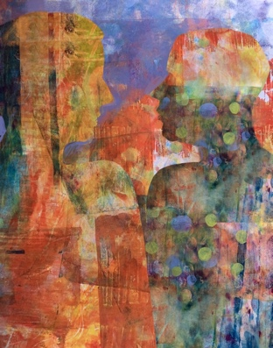
Ethical Leadership:
A Primer
Chapter 3
Utilitarianism
Alexandra K. Perry

Slide 2
Framing Question
‘How do leaders create the greatest good for the greatest number?’

Slide 3
Timeline

Slide 4
History
Aristippus (Circa 435-356 BCE)
Chinese Mohist thinkers (5th Century BCE)
Jeremy Bentham (1724–1804)
  An Introduction to the Principles of Morals and Legislation
John Stewart Mill (1806–1873)
  Utilitarianism
R.M. Hare (1919–2002)
Peter Singer (1946 –

Slide 5
Major Concepts
Utilitarian calculus
What is the greatest good for the greatest number of people?

Slide 6
Critiques
What about the minority?
Limits to the consideration of consequences
Inherent moral value

Slide 7
Key Quote
‘In utilitarian ethics, the primary concerns are placed in the domains of the goal and the context on the Five Components of Leadership Model.’

Slide 9
Case Study: The Smithsonian’s Enola Gay controversy

Slide 11
Discussion Questions
Is it ever ethical to display objects in museums that helped to create untold horror?
Consider the Kantian critique of utilitarianism. Is there a danger to defining ‘right’ and ‘wrong’ based on the happiness of the majority?
How does utilitarianism differ from hedonism, the theory that everyone should do what makes them happy?
The case study presents museum curators as leaders in the Enola Gay case. How would the case differ if we defined the U.S. military as having a leadership role? What would that role look like, and what obligations would the military have?

